Slide 1
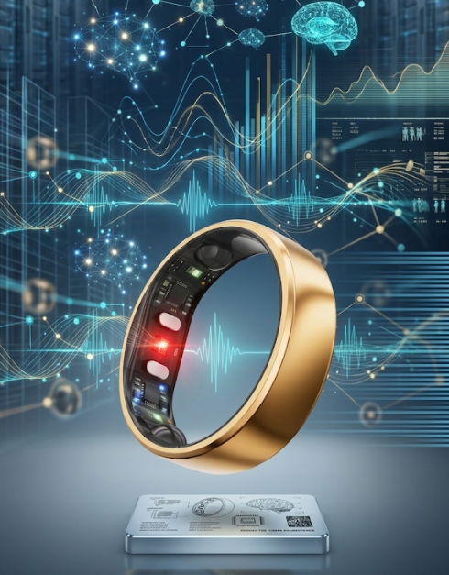
Smart Rings
BME 3113 Wearable Technology Studio
Troy Horvath

Slide 2
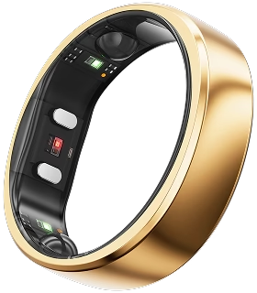
Value Proposition
Hardware
Useability
Assembly
Connectivity
Review
Retail
References

Slide 3
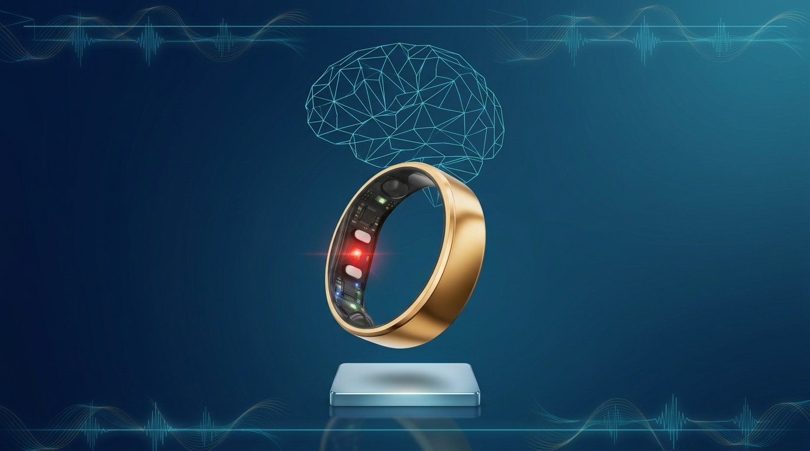
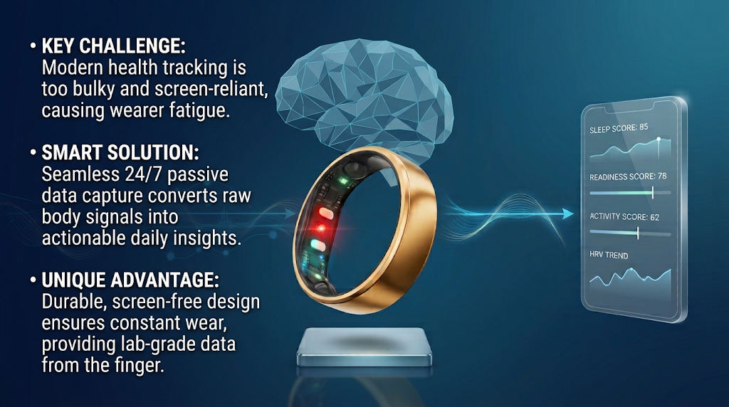
Value Proposition
Main Page
What is it: The Smart Ring is a active, non-invasive biometric biosensor
Mission: Through lightweight, effortless wearability, and easily accessible insights, the Ring will allow individuals to optimize their health and recovery by delivering physiological monitoring.

Slide 4
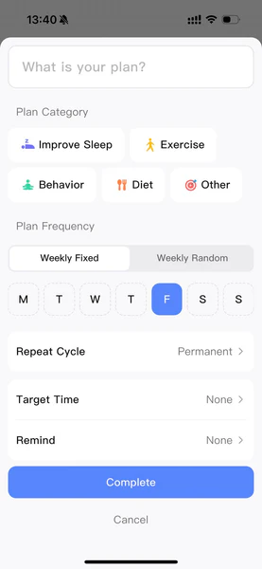
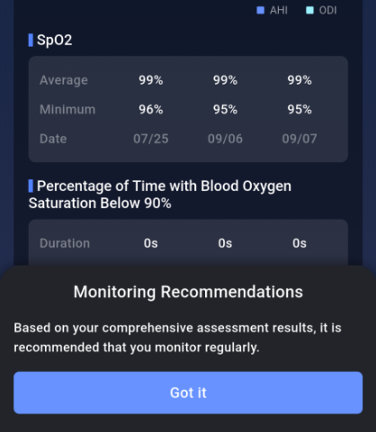
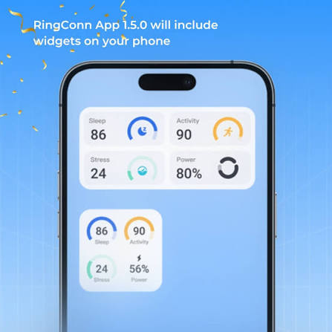
User input/output
Main Page
Inputs (Data Capture):
Passive Biometric Sensing
PPG (Heart Rate, Heart Rate Variability, Respiratory Rate)
Skin Temperature Trends
Movement & Sleep Tracking
Active User Logging (Manual habits)
Outputs (User Insights):
Dailey Scores (0-100): Readiness, Sleep, and Activity Scores
Actionable Guidance: Recovery Recommendations and trend charts

Slide 5


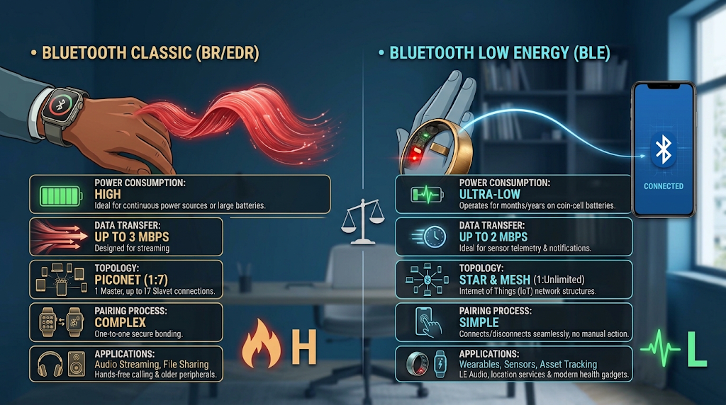
App connectivity
Main Page
Wireless Transmission:
Bluetooth Low Energy: Short-range background syncing that minimizes ring battery drain
On-board Storage: Internal flash memory stores several days of biometric data when disconnected from Iphone
Ecosystem Integrations:
Health Platforms: Including sync to Apple Healthkit, Google Health, RingConn App, etc..
Fitness Platforms: Automatically exports recorded workouts and imports external workouts to refine Readiness and Activity Scores

Slide 6
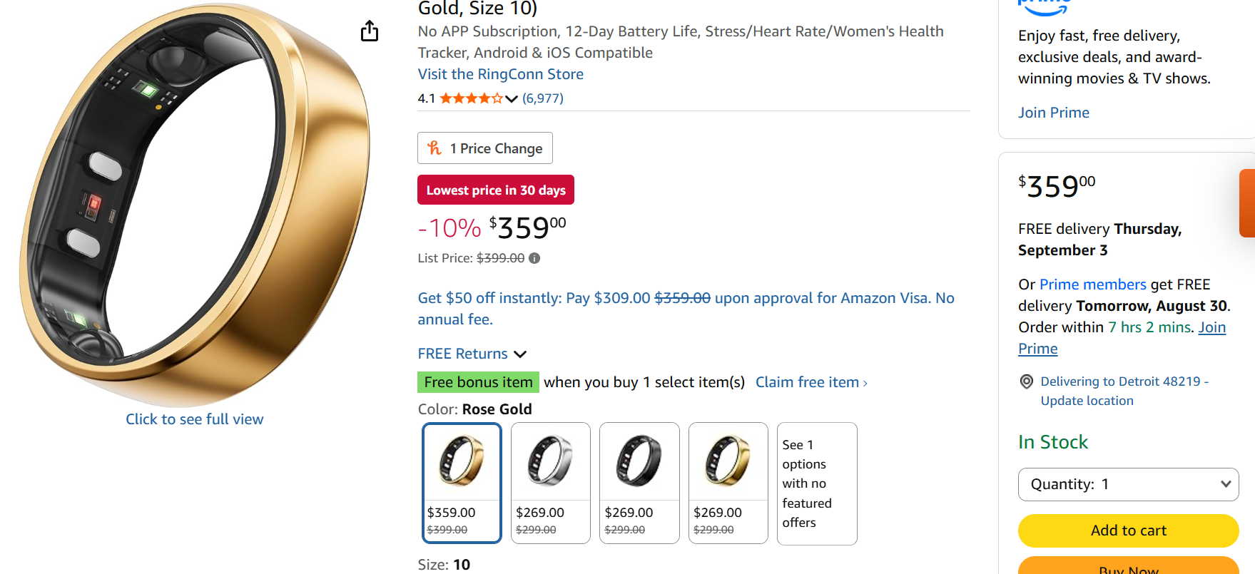
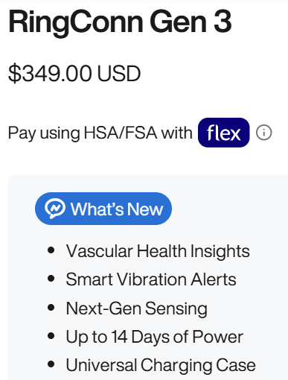
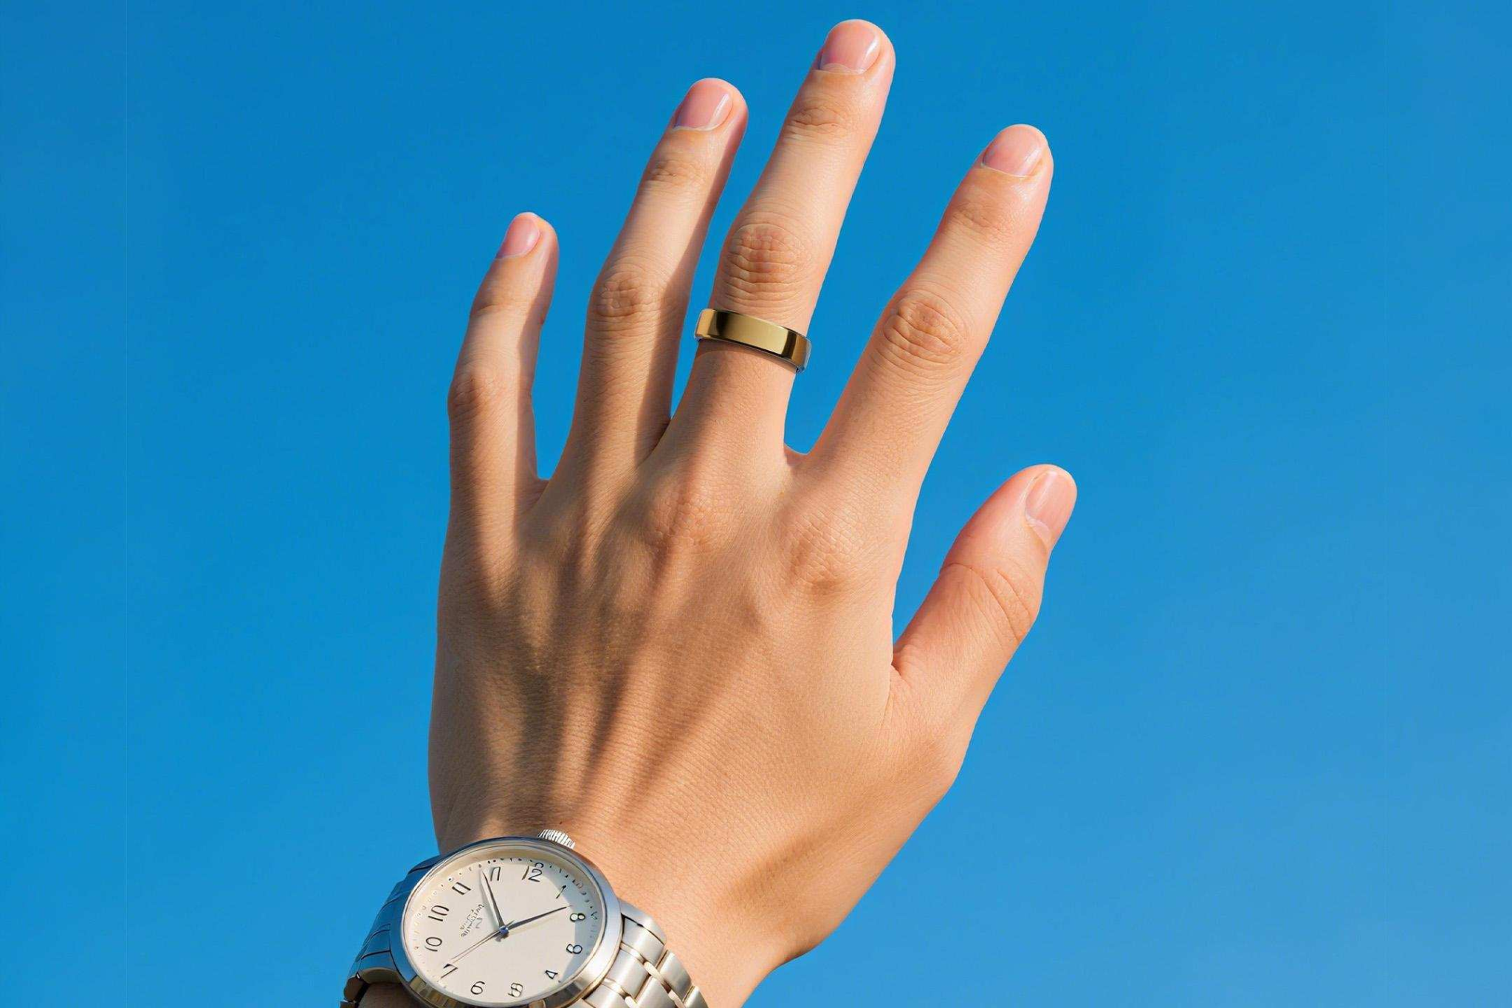
Retail
Main Page
RingConn Website
Distribution:
Direct to Consumer
Retail Partners (BestBuy, Target)
Sizing Friction:
At-Home Sizing Kits: Plastic Sizing Kits to wear for 24 hours before receiving their final ring size
In-store Fitting
Sale:
Hardware Sale: ($299-$499)
Recurring Membership: Subscription required to unlock full analysis ($5.99/month)

Slide 7
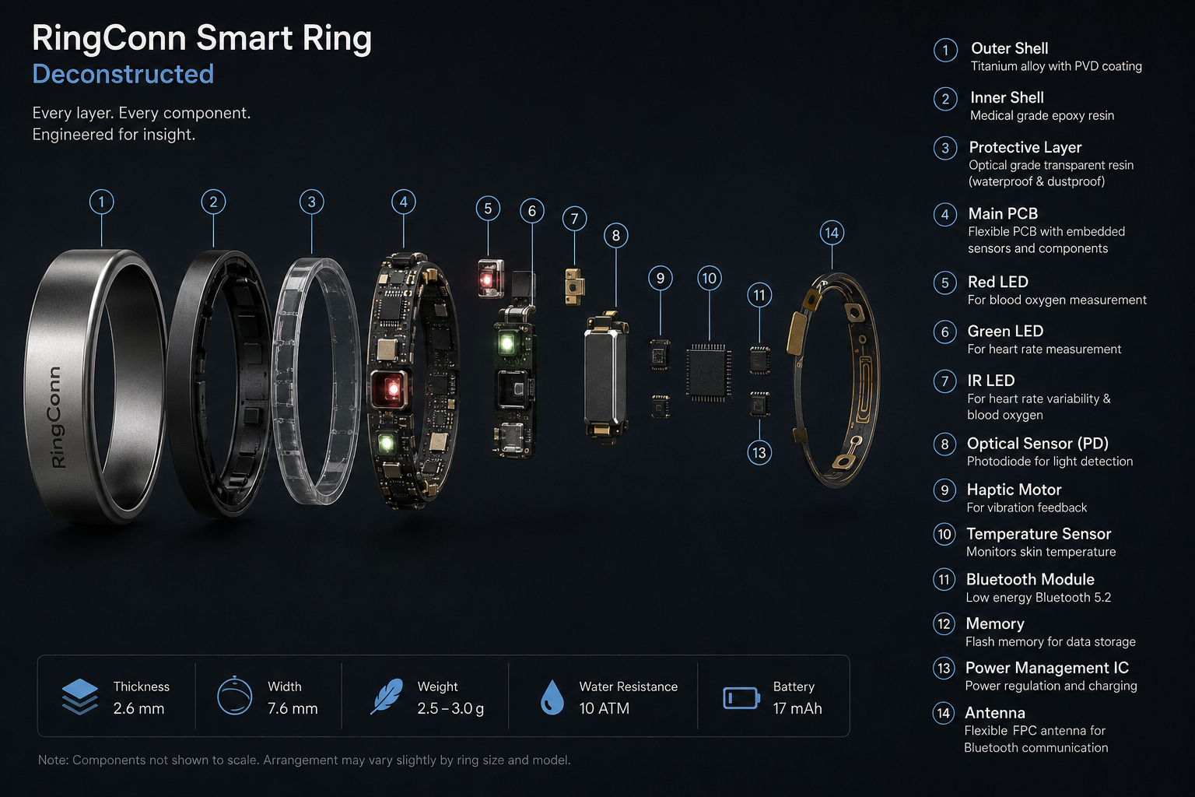
Hardware
Main Page
Biometric & Optical Sensors:
Photoplethysmography Sensor (PPG): Multi-wavelength setup using green, red and infrared LEDs to track heart rate, blood oxygen saturation and HRV
Temperature Detection: Thermistors that use skin temperature to determine circadian rhythm and sleep recovery
Motion & Inertial Hardware
Accelerometer: Tracks multi-directional movement to monitor steps, physical activity, energy expenditure, and sleep stages
Processing, Connectivity & Power
Bluetooth Low Energy Chip: Allows background syncing at low power
Microcontroller Unit: Algorithmic data processing
Lithium-ion Battery: Rechargeable
Power Management Integrated Circuit: Power Distribution
Structural Build:
Outer Shell: Lightweight Titanium Frame coated with a protective finish
Inner Molding (Resin): Epoxy Resin to protect helping

Slide 8
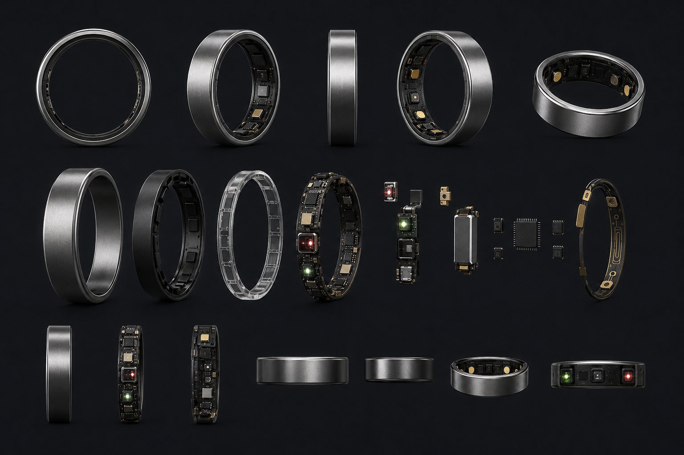
Assembly
Main Page
Component Stacking/Micro-Soldering: Printed Circuit Boards, BLE, etc.
Sensor Integration: Multi-wavelength PPG sensor, accelerometer and thermistors
Power Cell Insertion: Lithium-ion Battery
Inner Molding/Resin Sealing: Assembly is sealed together keeping sensors flush
Titanium/SS Encasement
Quality Control/Calibration: Automated Optical Inspection

Slide 9
Review
Main Page
Ring Strengths
Low-Profile Form Factor: Lightweight, titanium (very biocompatible), comfortable to wear without the need for a screen.
BioTracking: Passive Collection of HR, HRV, temperature, and sleep stages
Actionable Readiness Insights: Clear framework for recovery
Areas for Improvement
Sizing Accuracy: Half Sizes or micro adjustment features
Enhanced Workout: Expanding real-time heart rate during high-intensity intervals or heavy lifting would improve utility for serious athletes who rely on chest straps or watches for gym session.

Slide 10
References
Main Page
RingConn App User Guide
Bluetooth vs. Bluetooth Low Energy Comparison
RingConn Gen 3 Information
RingConn Sizing Kit
RingConn App Features
RingConn Amazon

